Slide 1




d
arvind
#1
Spring boot
Spring boot
caching
Microservices
Distributed system

Slide 2
Real world scenario
database
Doctor Portal

Slide 3
Real world scenario - 2
Location services
Doctor Portal
Fraud check

Slide 4
What is caching??
Caching keeps frequently accessed objects, images and data closer to where you need them, speeding up access and saving monetary cost.
Between client and server
Application layer and database layer
In general between any 2 layers

Slide 5
When to use caching??
There is repetitive data return for same input
To save monetary cost
To improve latency among layers

Slide 6
d
arvind
#2
Spring boot
Spring boot
@EnableCaching
@Cacheable
@CacheEvict
@CachePut
@Caching
@CacheConfig
Different Cache Providers
Setting Eviction/TTL policy
caching
caching
Green
Learner

Slide 8
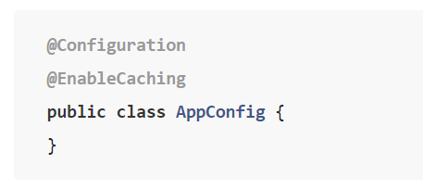
@EnableCaching
Enables the cache for the application

Slide 9
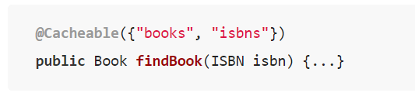
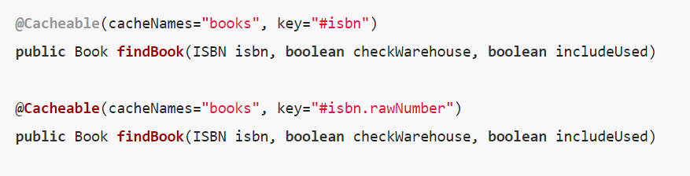
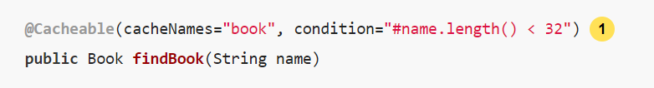
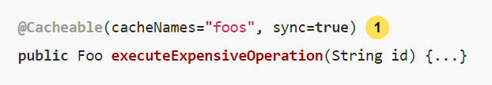
@cacheable
Used with the methods that are cacheable
cacheManager
cacheResolver
Synchronized Caching

Slide 10
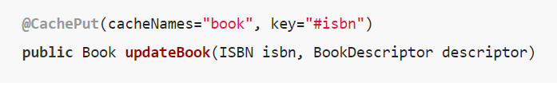
@CachePut
To update the cache

Slide 11
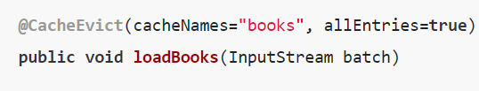
@CacheEvict
To clear the cache values from cache storage

Slide 12
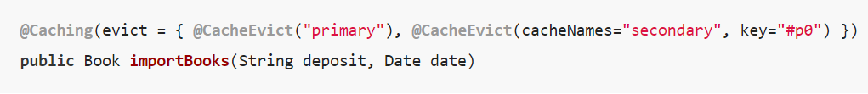
@Caching
To specify multiple annotations of the same type (such as @CacheEvict or @CachePut)

Slide 13
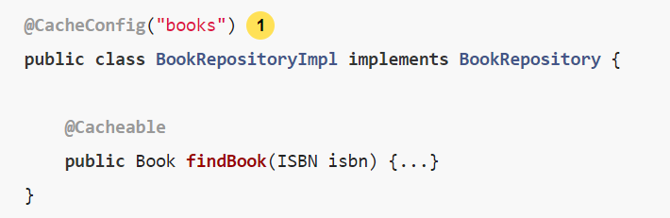
@CacheConfig
Class level
For all the methods of the class

Slide 14
Different Cache Providers
JDK ConcurrentMap-based Cache
Ehcache-based Cache
Caffeine Cache

Slide 15
How can I Set the TTL/TTI/Eviction policy/XXX feature?
Directly through your cache provider.
The cache abstraction is an abstraction, not a cache implementation.

Slide 16
d
arvind
#3
Spring boot
Spring boot
Spring Boot
Project Setup
caching
caching
Green
Learner

Slide 17
Database-
MySQL
Library Application

Slide 18
d
arvind
#4
Spring boot
Spring boot
Demo with Spring boot
Caching annotations in action
@EnableCaching
@Cacheable
@CacheEvict
@CachePut
caching
caching
Green
Learner

Slide 19
Demo - app
Database-
MySQL
Library Application

Slide 20
d
arvind
#5
Spring boot
Spring boot
Demo with Spring boot
Caching annotations in action
Customization - ConcurrentMapCacheManager
caching
caching
Green
Learner

Slide 21
d
arvind
#6
Spring boot
Spring boot
Ehcache
Theory
caching
caching
Green
Learner

Slide 22
What is ehcache
Java based
Distributed cache
Open source
General purpose caching
‘ehcache’ word is palindrome
developed by Greg Luck starting in 2003
Terracota Inc provides paid support[bought in 2009]

